Slide 1
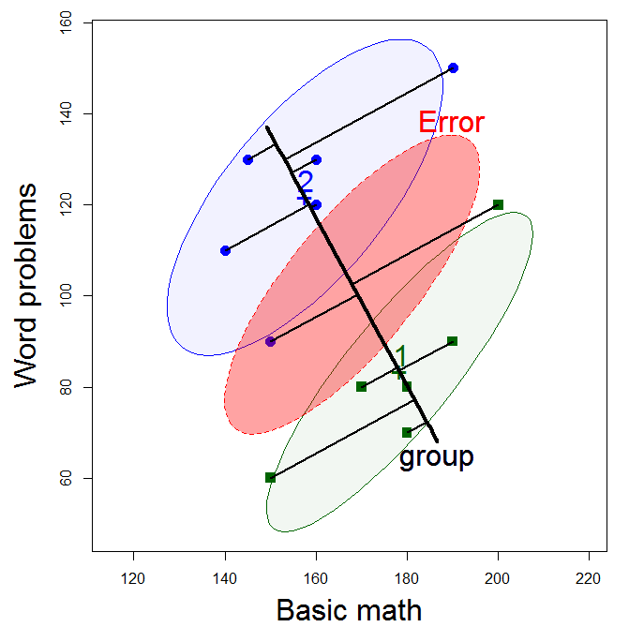
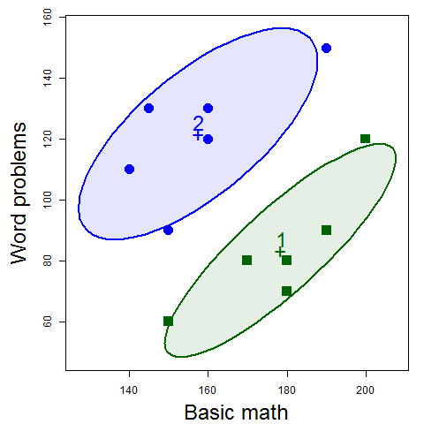
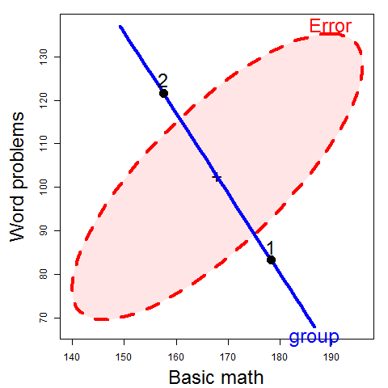
Visualizing Linear Models: An R Bag of Tricks Session 2: Multivariate Models
Data ellipses
HE plot
Michael Friendly
SCS Short Course
Oct-Nov 2022
https://friendly.github.io/VisMLM-course/

Slide 2
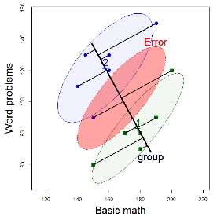
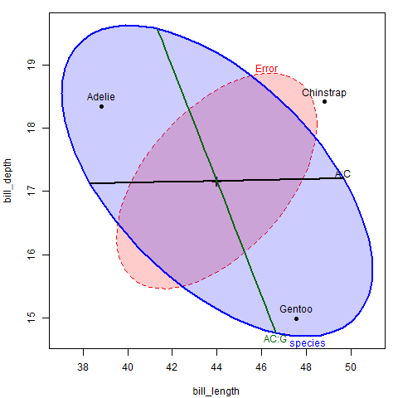
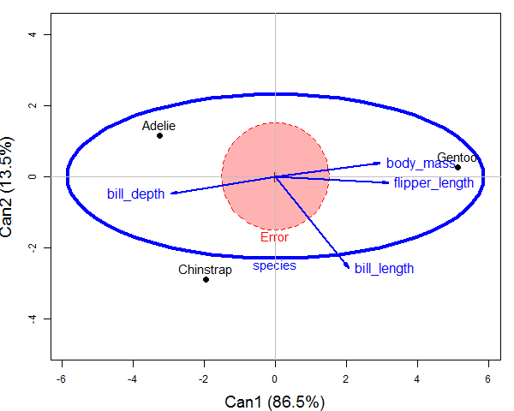
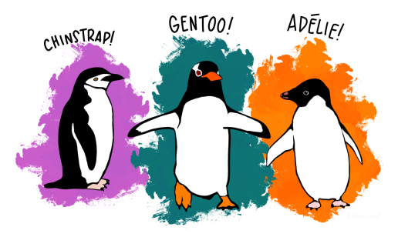
Today’s topics
Brief review of the GLM & MLM
Data ellipses
sufficient visual summaries
HE plot framework
H & E matrices/ellipses
Discriminant/canonical views
Example: Penguins data
Checking assumptions

Slide 3
One-way MANOVA
p responses, 1 “factor” (IV), g groups
H_{o}: μ₁ = μ₂ = … μ_{g}
H₁: at least one group centroid is different
Assumptions:
Independent groups, independent observations
Responses are independent, multivariate normal w/in each group
Pop. within-group covariance matrices are equal across groups
H₀: Σ₁ = Σ₂ = … = Σ_{g}
(Σ estimated by S = E / df_{e})
tested by e.g., Box’s test, heplots::boxM
→ y_{ij} _{(p x 1)} ~ N ( μ_{j}, Σ)

Slide 4
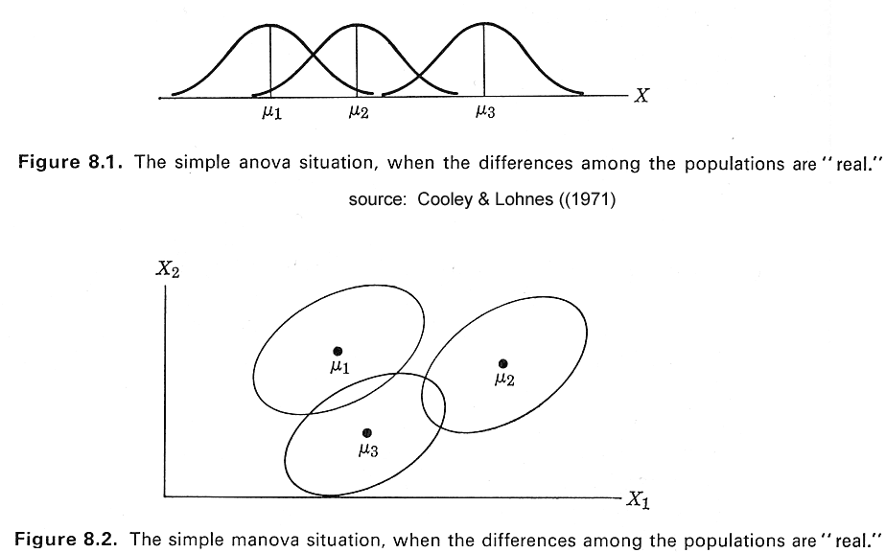
One-way ANOVA vs. MANOVA
ANOVA
Do means differ?
(Assume equal within-group variances)
MANOVA
How do centroids differ?
How many dimensions?
(Assume equal within-group variance-covariance matrices)

Slide 5
Response dimensions
Means on Y₁ and Y₂ are nearly perfectly correlated
Means on Y₁ and Y₂ have a low correlation
Y₂
Y₂
Y₁
Y₁
Only 1 dimension required to understand the group effect
Two different aspects are reflected in group means

Slide 6
GLM: the design matrix (X)
In the full GLM, the design matrix (X) may consist of:
A constant, 1, for the intercept (usually implicit)
Quantitative regressors: age, income, education
Transformed regressors: √age, log(income)
Polynomial terms: age², age³, …
Categorical predictors (“factors”, class variables): treatment (control, drug A, drug B), sex
Interactions: treatment * sex, age * sex
Model formulae in R define y ~ X:
prestige ~ income + education # 2 main effects
prestige ~ income * education # + interaction
prestige ~ income + education + women + type # 4 main effects
prestige ~ education + poly(women, 2) + log(income)*type

Slide 7
Univariate linear model
Model
Sums of squares
Hypothesis tests
matrix of predictors, factors, …
data
fit
residuals
How big is hypothesis variation relative to error variation?
mean square is a variance estimate

Slide 8
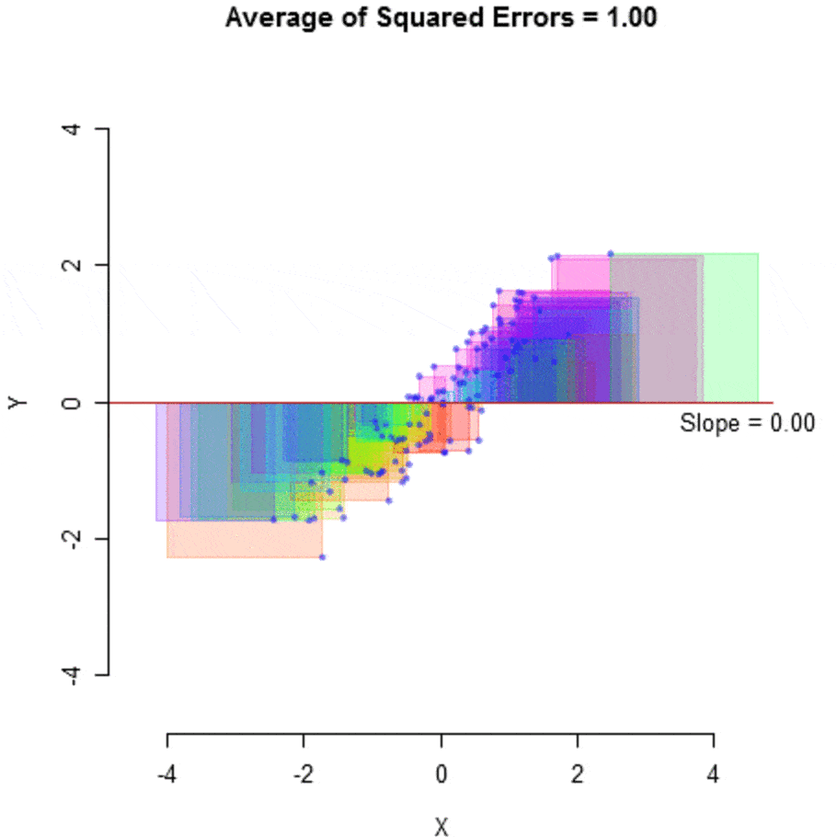
Least squares: SS_{T} and SS_{E}
In simple linear regression,
the intercept b₀ & slope b₁ are values that minimize the SS_{E} (or MS_{E})
SS_{T} is that value when b₁=0
b₁ | MS_{E}
.00 | 1.0
.89 | 0.2

Slide 9
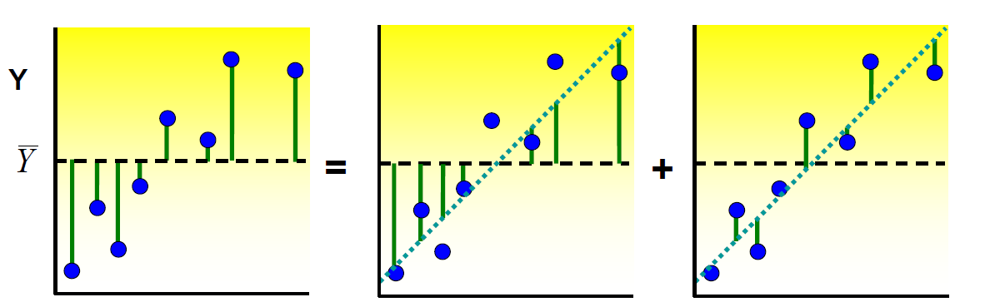
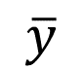
Regression: Visualizing SS_{T} = SS_{H} + SS_{E}
Total variance (SS_{T}) = Regression variance (SS_{H}) + Residual variance (SS_{E})
$$\overline{y}$$
F test: How much better is the fitted regression line (β = b̂) than the flat line (β = 0) ?

Slide 10
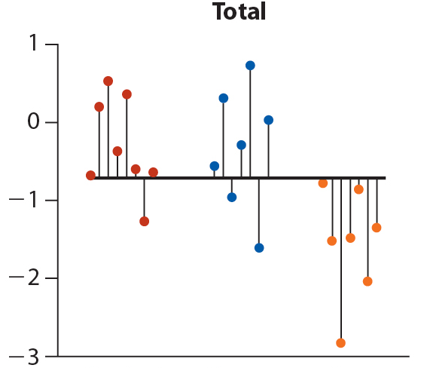
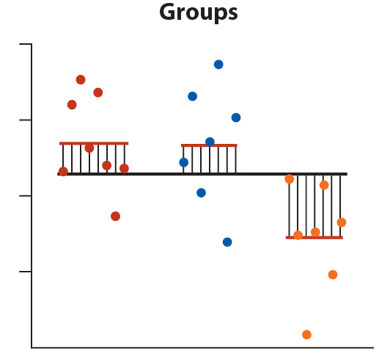
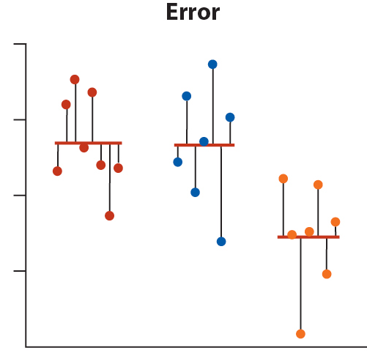
ANOVA: Visualizing SS_{T} = SS_{H} + SS_{E}
Total variance = Between group variance + Within group variance
Response
Control Group A Group B Control Group A Group B Control Group A Group B
F test: How much better is the groups model than the model ignoring groups?

Slide 11
Which means differ?
In ANOVA, when a factor is significant, follow-up to find which means differ
Post-hoc tests:
all-pairwise comparisons
all treatments vs. control group
Need to correct for multiple testing– control family-wise error rate
Bonferroni: α_{i} = α_{FW} / k [too conservative]
Tukey pairwise: “honestly significant difference”
many others: Dunnett’s test, Sidak, FDR, …

Slide 12
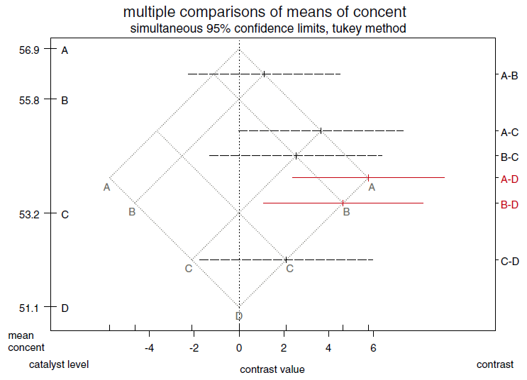
Plotting multiple comparisons
HH::mmcplot() – the mean-mean multiple comparison plot shows multiple comparisons or contrasts for any linear model
library(HH)
catalystm.lm <- lm(concent ~ catalyst, data=catalystm)
catalystm.mmc <-mmc(catalystm.lm, linfct = mcp(catalyst = "Tukey"))
mmcplot(catalystm.mmc)
Construction:
plot means, y̅_{i}, y̅_{j} on grid
rotate 45º
horizontal axis shows: y̅_{I} - y̅_{j}
SE determined by MC method
signif. comparisons highlighted

Slide 13
Contrasts: planned comparisons
Better to test specific, planned comparisons, rather than all-pairwise
A contrast is a weighted sum, L, of the means, with weights, c, that sum to zero
L = c’ μ = Σ c_{i} μ_{i} such that Σ c_{i} = 0
In words: average of one subset of groups vs. another subset
Any r-1 linearly independent contrasts → same overall test
A priori contrasts can be tested w/o adjusting 
r=4 groups

Slide 14
The X matrix for a factor can be represented by a set of r-1 contrasts, combined with the unit vector
X _{(r x r)} = ( 1, C )
Some special contrasts:
c1 c2 c3
Deviation contrasts
Helmert contrasts
Polynomial contrasts
lin quad cubic
each treatment vs control or baseline [not orthogonal]
ordered treatments: each vs all the rest [always orthogonal]
quantitative treatment levels [orthogonal]

Slide 15
Using contrasts in R
R has 4 basic functions for generating contrasts for a factor
Dummy coding, aka “reference level”, “treatment” contrasts
Deviation coding, aka “sum-to-zero” constraints
Polynomial contrasts for an ordered/quantitative factor
Helmert contrasts for ordered factor comparisons
Defaults are set separately for unordered and ordered factors
Define your own by assigning a matrix to contrasts(myfactor)<- cmat
These affect the tests of coefficients, but not overall tests
> contr.treatment(4)
2 3 4
1 0 0 0
2 1 0 0
3 0 1 0
4 0 0 1
> contr.sum(4)
[,1] [,2] [,3]
1 1 0 0
2 0 1 0
3 0 0 1
4 -1 -1 -1
> contr.poly(4)
.L .Q .C
[1,] -0.6708 0.5 -0.2236
[2,] -0.2236 -0.5 0.6708
[3,] 0.2236 -0.5 -0.6708
[4,] 0.6708 0.5 0.2236
> options("contrasts")
$contrasts
unordered ordered
"contr.treatment" "contr.poly"
> contr.helmert(4)
[,1] [,2] [,3]
1 -1 -1 -1
2 1 -1 -1
3 0 2 -1
4 0 0 3
See: http://www.ats.ucla.edu/stat/r/library/contrast_coding.htm

Slide 16
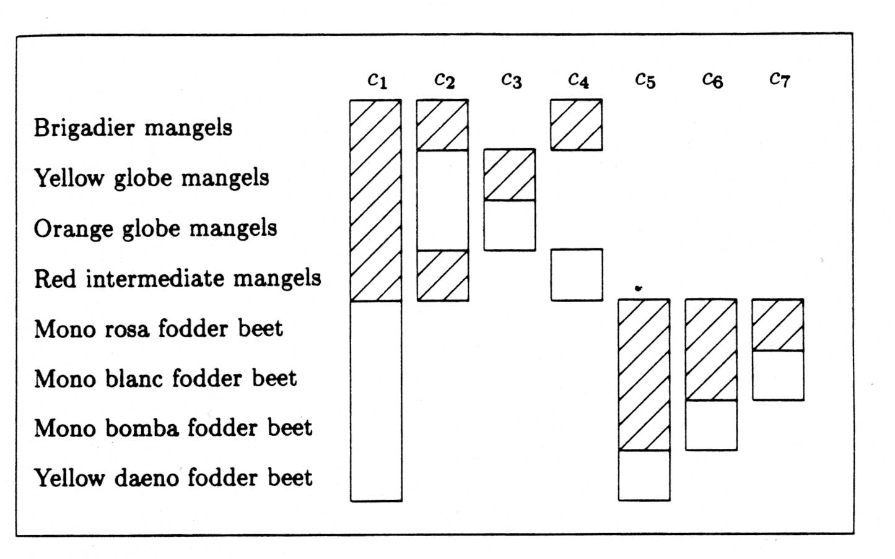
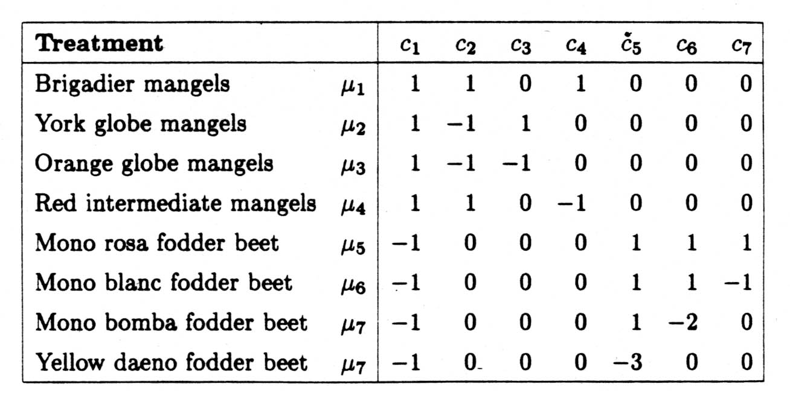
Nested dichotomies
Orthogonal contrasts can always be generated as nested dichotomies
They correspond to independent research questions
Sums of squares decompose the overall effect
SS_{A} = SS_{c1} + SS_{c2} + … + SS_{c(r-1)}
c₁ = mangles vs beets
c₂ = globe mangles vs other
c₅ = mono beets vs yellow

Slide 17
Multivariate linear model
Model
Sums of squares & cross-products
Hypothesis tests
Eigenvalues λ_{i}, i=1:p of H E⁻¹
Wilks’ Λ, Pillai & Hotelling trace, Roy’s test
how many dimensions (aspects of responses)?
matrix of p responses
How big is hypothesis variation relative to error variation?
Ah, but there are up to s = min(p, df_{h}) dimensions of size

Slide 18
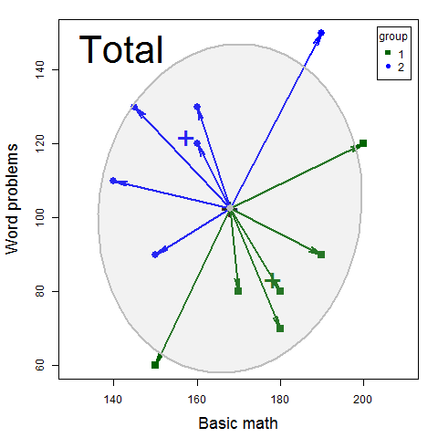
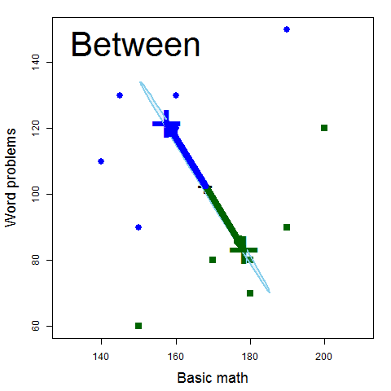
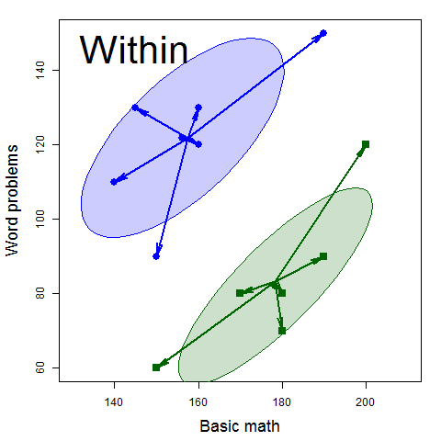
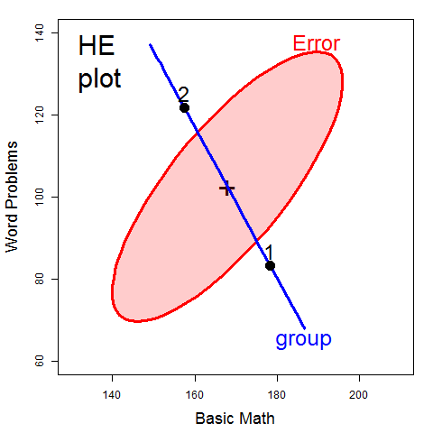
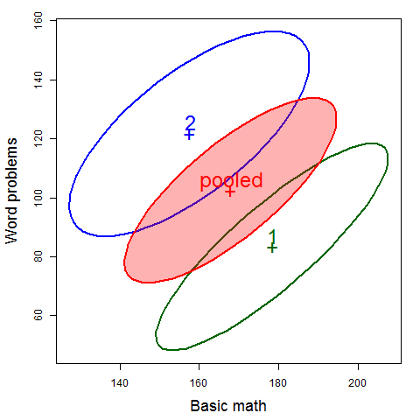
Visualizing SSP_{T} = SSP_{H} + SSP_{E}
=
+
scale & overlay
pool→ SSP_{E}
Within
Total
Between

Slide 19
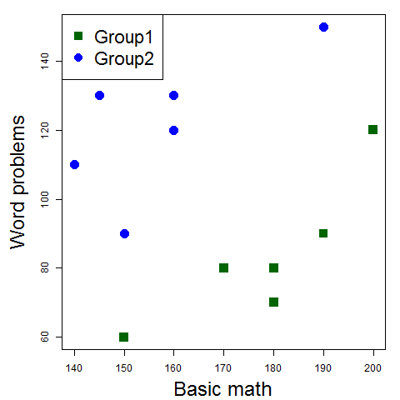
Data ellipsoids
The data ellipsoid is a sufficient visual summary for multivariate location & scatter, just as are sufficient for
Data
Data ellipses

Slide 20
Data ellipsoids: definitions
For a p-dimensional multivariate sample, Y_{N×p} , the sample mean vector, , and sample covariance matrix, S, are minimally sufficient statistics under classical (gaussian) assumptions.
These can be represented visually by the p-dimensional data ellipsoid, of size (“radius”) c centered at ,
→ an ellipsoid centered at the means whose size & shape reflects variances & covariances
We consider this a minimally sufficient visual summary of multivariate location and scatter.
or, D_{M}² (y) ≤ c²

Slide 21
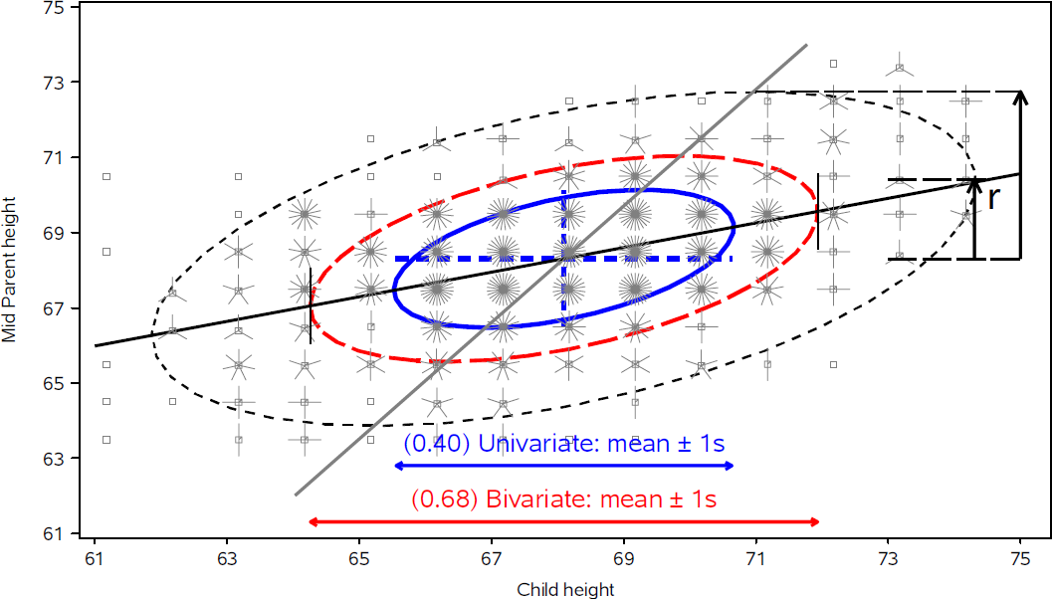
Data ellipsoids: properties
Ellipsoid boundary: Mahalanobis D_{M}² (y_{i}) ~ χ_{p}²
p=2: shadows generalize univariate confidence intervals
eccentricity: precision; visual estimate of correlation
r ≈ 0.5 here

Slide 22
The HE plot framework
Hypothesis-Error (HE) plots
Visualize multivariate tests in the MLM
Linear hypotheses--- lower-dimensional ellipsoids
Extension: HE plot matrices
Canonical displays
low-dimensional multivariate juicers
shows data in the space of maximal effects
Covariance ellipsoids
visualize tests of homogeneity of covariance matrices
For all: robust methods are available or good research projects!

Slide 23
HE plot framework: Trivial example
Two groups of middle-school students are taught algebra by instructors using different methods, and then tested on:
BM: basic math problems (7 * 23 – 2 * 9 = ?)
WP: word problems (“a train travels at 23 mph for 7 hours, but for 2 hours …”)
Do the groups differ on (BM, WP) by a multivariate test?
If so, how ???
> data(mathscore, package="heplots")
> mod <- lm(cbind(BM, WP) ~ group, data=mathscore)
> Anova(mod)
Type II MANOVA Tests: Pillai test statistic
Df test stat approx F num Df den Df Pr(>F)
group 1 0.86518 28.878 2 9 0.0001213 ***
---
Signif. codes: 0 ‘***’ 0.001 ‘**’ 0.01 ‘*’ 0.05 ‘.’ 0.1 ‘ ’ 1
✓

Slide 24
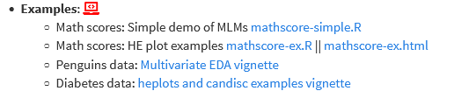
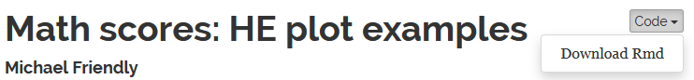
Follow along
The R script (mathscore-ex.R) for this example is linked on the course page. Download and open in R Studio to follow along.
HW: explore other examples
The script was run with `knitr` (ctrl+shift+K) in R Studio to create the HTML output (mathscore-ex.html)
The Code button there allows you do download the R code and comments
(R notebooks are a simple way to turn R scripts into finished documents)

Slide 25
Why do multivariate tests?
Could do univariate ANOVAs (or t-tests) on each response variable (BM, WP)
> Anova(lm(BM ~ group, data=mathscore))
Anova Table (Type II tests)
Response: BM
Sum Sq Df F value Pr(>F)
group 1302 1 4.24 0.066 .
Residuals 3071 10
> Anova(lm(WP ~ group, data=mathscore))
Anova Table (Type II tests)
Response: WP
Sum Sq Df F value Pr(>F)
group 4408 1 10.4 0.009 **
Residuals 4217 10
✗
✓
From this, might conclude that:
Groups don’t differ on Basic Math score ✗
Groups are significantly different on Word problems ✓
Multivariate tests:
Do not require correcting for multiple tests (e.g., Bonferroni)
Combine evidence from multiple response variables (“pooling strength”)
Show how the multivariate responses are jointly related to the predictors
How many aspects (dimensions?)

Slide 26
Why do multivariate tests?
Overall test is highly significant:
Combines the evidence for all predictors
Takes response correlations into account
✓
✓
> mod <- lm(cbind(BM, WP) ~ group, data=mathscore)
> Anova(mod)
Type II MANOVA Tests: Pillai test statistic
Df test stat approx F num Df den Df Pr(>F)
group 1 0.86518 28.878 2 9 0.0001213 ***
Visual test of significance (Roy’s test)
The H ellipse projects outside the E ellipse iff the effect is significant.
HE plot provides an interpretation:
Group 1 > Group 2 on Basic Math, but worse on Word Problems
Group 2 > Group 1 on Word Problems, but worse on Basic Math
BM & WP are + correlated w/in groups

Slide 27
HE plot framework: Visual overview
The data ellipsoid is a sufficient visual summary for multivariate location & scatter, just as are sufficient for
Data
Data ellipses

Slide 28
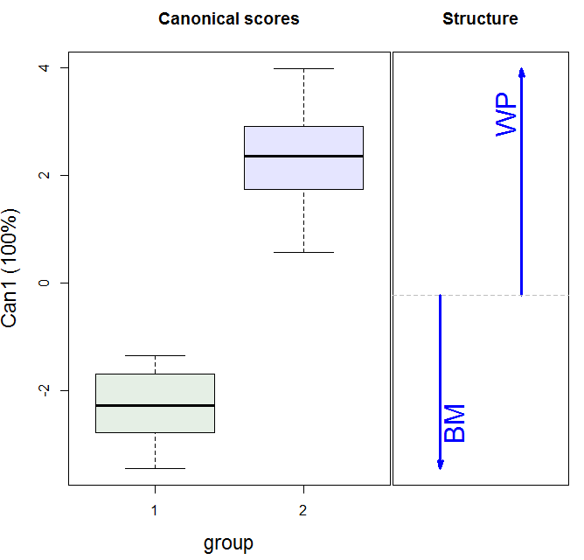
Data ellipses
HE plot
Visual overview
Canonical space
Discriminant scores

Slide 29
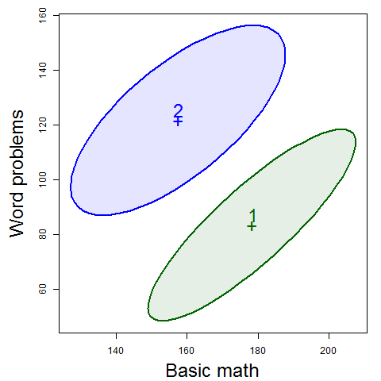
Data → Data ellipses → HE plot
Differences between group means are shown by the H ellipsoid– data ellipsoid of the fitted values (w/ 1 df, degenerates to a line)
Direction shows relation of groups to response variables
Size shows “how big is H relative to E”
Variation within groups is reflected in the E ellipsoid-- data ellipsoid of the residuals
Direction: residual (partial) correlation between BM & WP
Size/shape: residual variance

Slide 30
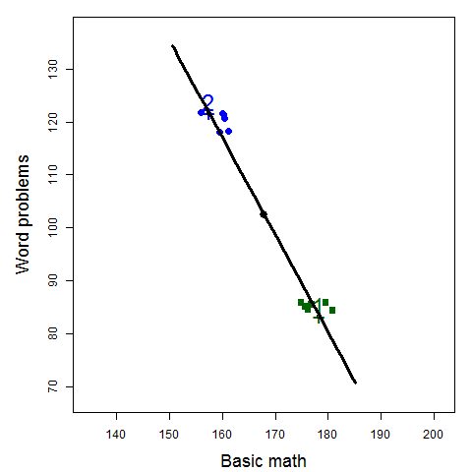
The H ellipse
Jittered fitted values
(gp means)
The H ellipse is the data ellipse of the fitted values (group means, here)
The H matrix is the sum of squares and crossproducts of the fitted values, corrected for the grand mean

Slide 31
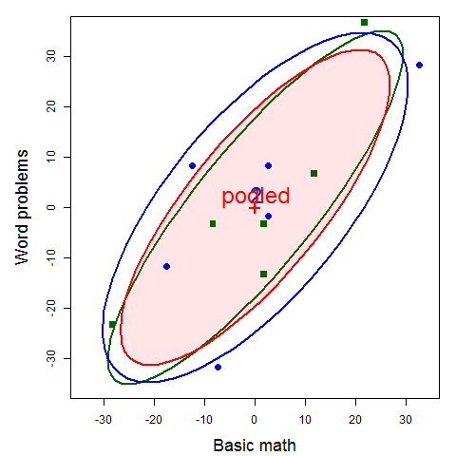
The E ellipse
The E ellipse is the data ellipse of the residuals
What you get when you subtract the group means from all observations, shifting them to the grand means.
E matrix called the “within-group pooled covariance matrix”

Slide 32
H & E in numbers
The H and E matrices are calculated in the car::Anova() function and saved as the SSP and SSPE components, used in the statistical tests.
> math.aov <- Anova(math.mod)
> (H <- math.aov$SSP)
$group
BM WP
BM 1302.1 -2395.8
WP -2395.8 4408.3
> fit
BM WP
1 178.33 83.333
2 178.33 83.333
3 178.33 83.333
4 178.33 83.333
5 178.33 83.333
6 178.33 83.333
7 157.50 121.667
8 157.50 121.667
9 157.50 121.667
10 157.50 121.667
11 157.50 121.667
12 157.50 121.667
Direct calculation:
> fit <- fitted(math.mod)
> ybar <- colMeans(mathscore[,2:3])
> n <- nrow(mathscore)
> crossprod(fit) - n*outer(ybar, ybar)
BM WP
BM 1302.1 -2395.8
WP -2395.8 4408.3

Slide 33
H & E in numbers
> (E <- math.aov$SSPE)
BM WP
BM 3070.8 2808.3
WP 2808.3 4216.7
Direct calculation:
> resids
BM WP
1 11.667 6.667
2 -8.333 -3.333
3 1.667 -3.333
4 21.667 36.667
5 -28.333 -23.333
6 1.667 -13.333
7 2.500 -1.667
8 32.500 28.333
9 -7.500 -31.667
10 2.500 8.333
11 -17.500 -11.667
12 -12.500 8.333
> resids <- residuals(math.mod)
> crossprod(resids)
BM WP
BM 3070.8 2808.3
WP 2808.3 4216.7
> cor(resids)
BM WP
BM 1.00 0.78
WP 0.78 1.00

Slide 34
Discriminant analysis
MANOVA and linear discriminant analysis (LDA) are intimately related and differ mainly in perspective:
MANOVA: Do means of groups on 2+ responses differ?
LDA: Find weighted sums of responses that best discriminate groups
In both cases,
Group differences are represented by the H matrix; residuals: E matrix
Test statistics based on eigenvalues of HE⁻¹
Discriminant weights are eigenvectors of HE⁻¹

Slide 35
Discriminant analysis
For 2 groups,
the discriminant axis is the line joining the two group centroids,
discriminant scores are the projections of observations on this line.
MASS:lda() does this analysis
> (mod.lda <- MASS::lda(group ~ ., mathscore))
Group means:
BM WP
1 178.3 83.33
2 157.5 121.67
Coefficients of linear discriminants:
LD1
BM -0.08350
WP 0.07527
The canonical dimension is Can1 = 0.075 WP - 0.083 BM, a contrast between the two tests

Slide 36
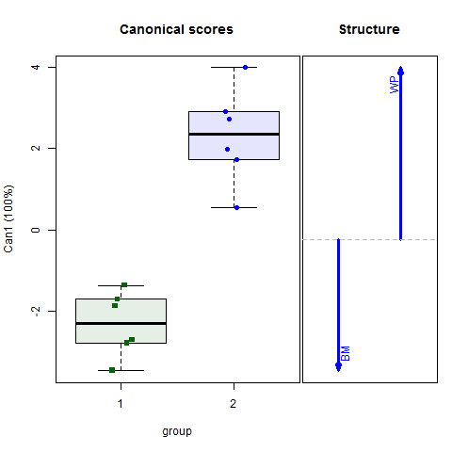
Canonical space
The HE plot view shows the data in data space
Easier to see effects by projecting scores to canonical space – the best-discriminating axes.
For a 1 df effect, there is only one canonical dimension
Arrows show the relative size & direction of discriminant weights
library(candisc)
mod.can <- candisc(math.mod)
plot(mod.can)

Slide 37

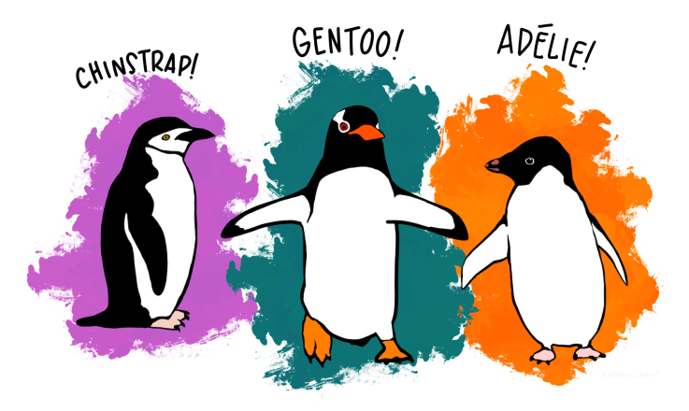
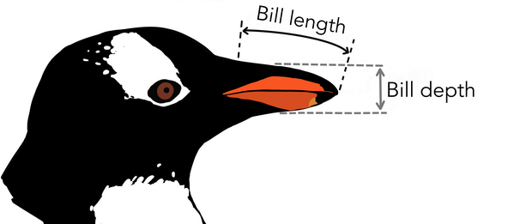
Penguin data
Data on 3 species of penguins, measured on 3 Antarctic islands
How does penguin “size” differ by species, island, … ?
> library(palmerpengiuns)
> peng <- penguins %>% rename(...) %>% ... # clean up names, etc.
> peng[sample(1:333, 5), ]
# A tibble: 5 x 8
species island bill_length bill_depth flipper_length body_mass sex year
<fct> <fct> <dbl> <dbl> <int> <int> <fct> <int>
1 Chinstrap Dream 58 17.8 181 3700 f 2007
2 Adelie Torgersen 39.6 17.2 196 3550 f 2008
3 Gentoo Biscoe 46.2 14.1 217 4375 f 2009
4 Chinstrap Dream 49 19.5 210 3950 m 2008
5 Gentoo Biscoe 50.4 15.7 222 5750 m 2009

Slide 38
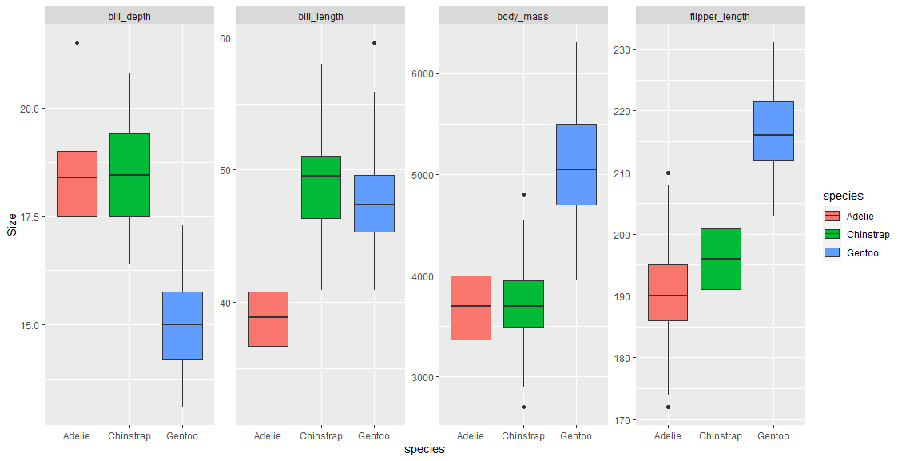
Penguins: Multivariate EDA
Boxplots by grouping variables (factors) are often useful for an initial overview
Can show multiple variables, but hard for >1 factor.
What is the pattern here?

Slide 39
Penguins: Multivariate EDA
Boxplots by grouping variables (factors) are often useful for an initial overview
Need to reshape data from wide to long format
peng_long <- peng |> # convert wide to long format
tidyr::gather(Measure, Size, bill_length:body_mass)
ggplot(peng_long, aes(x=species, y=Size, fill=species)) +
geom_boxplot() +
facet_wrap(. ~ Measure, scales="free_y", nrow=1)

Slide 40
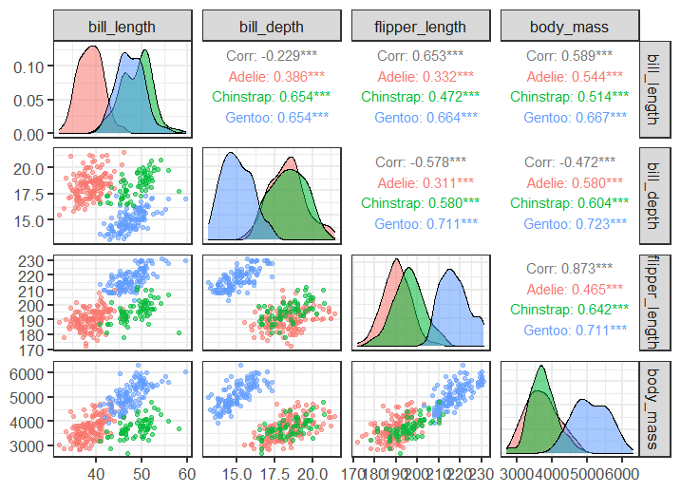
Scatterplot matrix with GGally
EDA should also include a scatterplot matrix
Here, plot the numeric variables, grouped by species
library(GGally)
ggpairs(peng, aes(color=species, alpha=0.5),columns=3:6)
Diagonals show univariate distributions
Lower Δ: scatterplots
Upper Δ: correlations

Slide 41
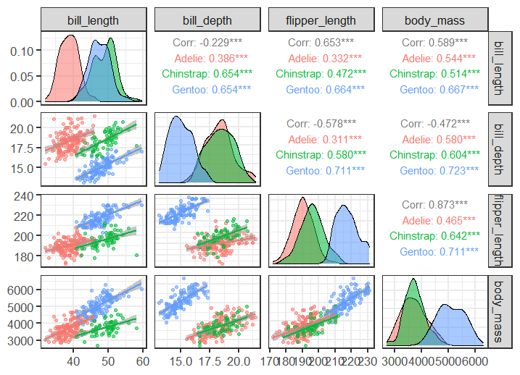
But wait: I want to see the regression lines!
No worries: define a custom function for scatterplot in the lower triangle
ggpanel <- function(data, mapping, ...){
p <- ggplot(data = data, mapping = mapping) +
geom_point() +
geom_smooth(method=lm, formula = y~x, ...)
p}
ggpairs(peng, aes(color=species, alpha=0.5), columns=3:6, lower = list(continuous = ggpanel))
All plots look reasonably linear ✓
But: there’s something weird in the correlations
Can you spot it?

Slide 42
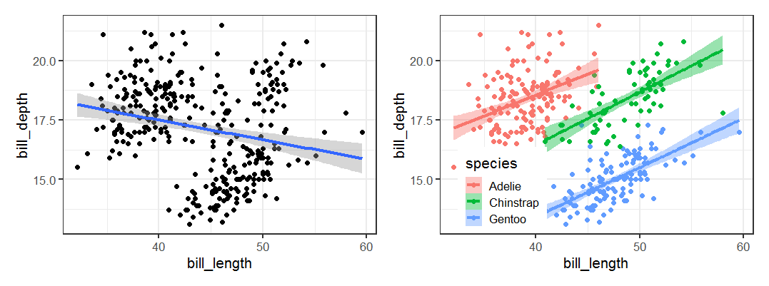
Simpson’s Paradox
Simpson’s paradox: within-group r s are reversed when the data are pooled
This happens here because the group means are negatively correlated
# Ignoring species
ggplot(peng, aes(x=bill_length, y=bill_depth)) +
geom_point() +
geom_smooth(method="lm", formula=y~x)
# Including species
ggplot(peng, aes(x=bill_length, y=bill_depth
color=species, fill=species)) +
geom_point() +
geom_smooth(method="lm", formula=y~x)

Slide 43
PCA & Biplots
For multivariate data, often want to view the data in a low-D space that shows the most total variance
PCA: finds weighted sums of variables which are:
Uncorrelated
Account for maximum variance
How many dimensions are necessary?
A biplot is a 2D (or 3D) plot of the largest PCA dimensions
Vectors in this plot show the original data variables
Points in this plot show the observations
Data ellipses here show within group relations

Slide 44
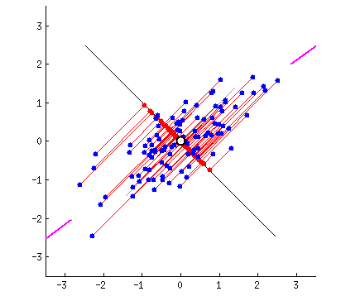
PCA animation
PCA:
PC1 is the direction along which points have max. variance
Equivalently, the perp. deviations from the line have min. residual SS
PCA by springs
Imagine each pt connected to a possible PC1 line by springs
Force ~ deviation²
Forces balance, naturally seek the min. residual SS position.
Voila, QED!
A visual proof

Slide 45
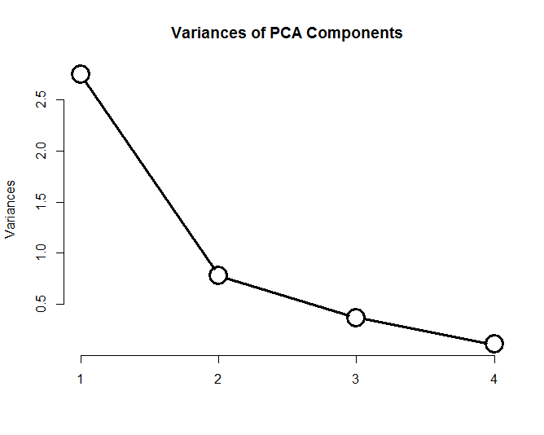
PCA
peng.pca <- prcomp (~ bill_length + bill_depth + flipper_length + body_mass,
data=peng,
na.action=na.omit,
scale. = TRUE)
screeplot(peng.pca, type = "line", lwd=3, cex=3,
main="Variances of PCA Components")
> summary(peng.pca)
Importance of components:
PC1 PC2 PC3 PC4
Standard deviation 1.657 0.882 0.6072 0.328
Proportion of Variance 0.686 0.195 0.0922 0.027
Cumulative Proportion 0.686 0.881 0.9730 1.000
2D: 88.1 %
3D: 97.3 %
See: https://rpubs.com/friendly/penguin-biplots for details

Slide 46
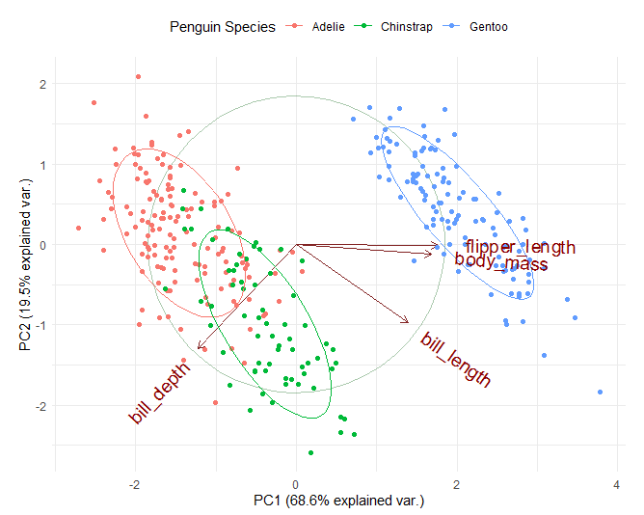
Biplot
library(ggbiplot)
ggbiplot(peng.pca, obs.scale = 1, var.scale = 1,
groups = peng$species,
ellipse = TRUE, circle = TRUE) +
scale_color_discrete(name = 'Penguin Species')
PC1, PC2 ~ 88.1% of variance
PC1: largely flipper length & body mass: “penguin size”
PC2 (& PC1): relates to “bill shape”
Easy to characterize the species in terms of these variables
Adelie
Gentoo
Chinstrap
See: https://rpubs.com/friendly/penguin-biplots

Slide 47
Penguins: MANOVA
Assume the goal is to determine whether/how the penguins differ in “size” by species
A MLM tests all 4 size variables together: ~ species
Could also use other factors: ~ species + sex + island
> peng.mod0 <-lm(cbind(bill_length, bill_depth, flipper_length, body_mass) ~ species,
data=peng)
> Anova(peng.mod0)
Type II MANOVA Tests: Pillai test statistic
Df test stat approx F num Df den Df Pr(>F)
species 2 1.64 371 8 656 <2e-16 ***
---
Signif. codes: 0 ‘***’ 0.001 ‘**’ 0.01 ‘*’ 0.05 ‘.’ 0.1 ‘ ’ 1
Yet, we are left to understand the nature of this effect wrt. the size variables.
See: https://rpubs.com/friendly/penguin-manova for details

Slide 48
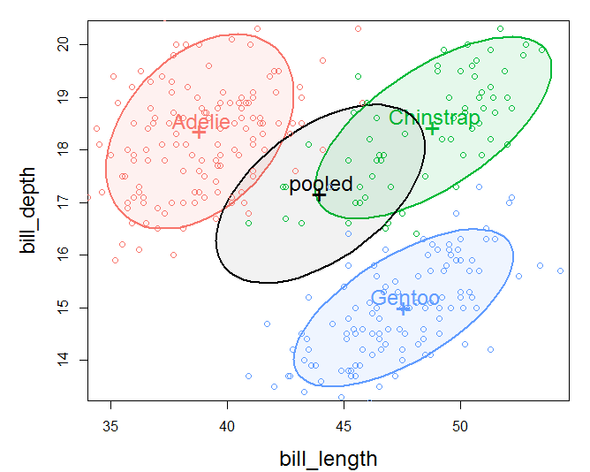
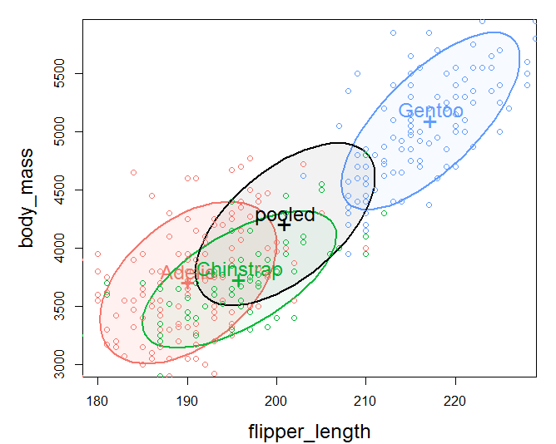
Penguins: view data ellipses
Data ellipses in 2D provide a good start for pairwise relations
bill depth & length
body mass & flipper length
group means negatively correlated
within group correlation > 0
group means positively correlated
within group correlation > 0

Slide 49
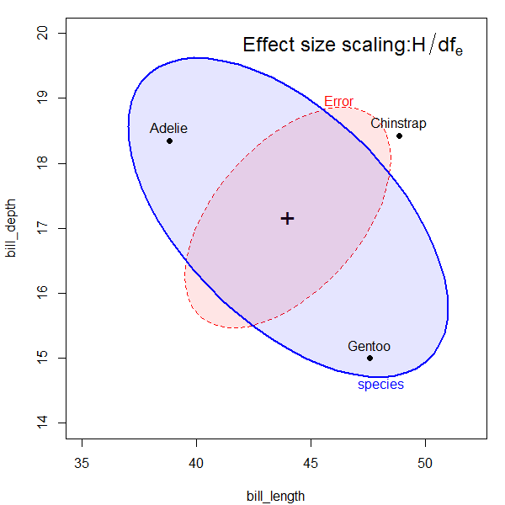
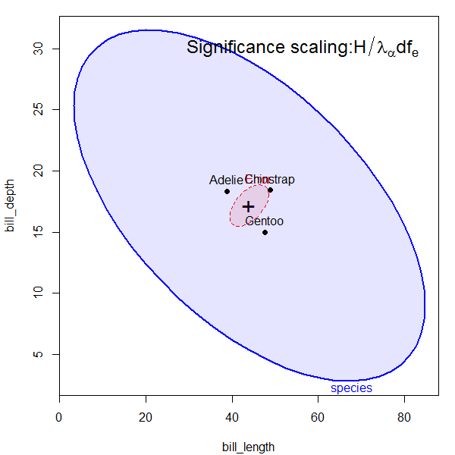
HE plot details
E ellipse reflects within-group error (co)variation
Size: E / df_{e} set to cover 68%, an analog of y̅ ± 1 std
Shift to grand mean for direct comparison with H
H ellipse reflects (co)variation of group means
effect size scaling, uses H/df_{e} to put this on the same scale as the E ellipse. Analog of effect size in univariate designs.
significance (“evidence”) scaling: uses H/λ_{α} df_{e} .
The H ellipse protrudes outside the E ellipse somewhere, iff an effect is significant (Roy’s largest root test) at p < α

Slide 50
Penguins: HE plots
Orientation of the H ellipse reflects negative correlation of the species means: species with larger bill depth have smaller bill length (bill “shape”?)
E ellipse: within species, larger bill length → larger bill depth
heplot(peng.mod0, size=“effect")
heplot(peng.mod0, size="evidence")

Slide 51
Contrasts
In linear models, any effect of df_{h} > 1 can be partitioned into df_{h} separate 1 df tests of contrasts
If orthogonal, H = H₁ + H₂ + … H _{dfh} -- accounts for total effect
Tested as a linear hypothesis, e.g., x₁ – (x₂ + x₃)/2 = 0
Each H_{i} has rank=1, so appears as a line in HE plots
Assume we want to compare the species as two contrasts:
Do Adelie differ from Chinstrap?
Do Gentoo penguins differ from the other two?
> contrasts(peng$species)<-matrix(c(1,-1, 0, -1, -1, -2), 3,2)
> contrasts(peng$species)
[,1] [,2]
Adelie 1 -1
Chinstrap -1 -1
Gentoo 0 2

Slide 52
Contrasts
hyp <- list("A:C"="species1","AC:G"="species2") # give names to contrasts
heplot(peng.mod0, fill=TRUE, fill.alpha=0.2,
hypotheses=hyp, size="effect")
Result is very clear:
Adelie & Chinstrap differ only in bill length
Gentoo differ from other two – longer, but less deep bills (bill shape)
Both of these are large effects!
Together, they are the entire species effect!

Slide 53
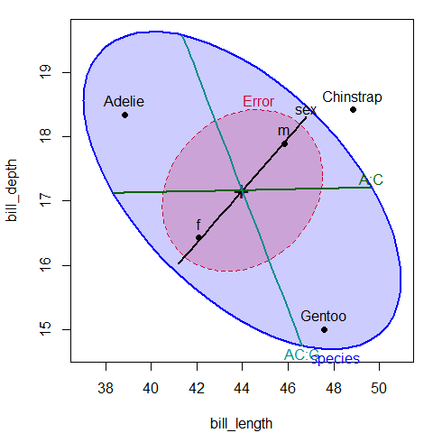
Other models
peng.mod2 <-lm(cbind(bill_length, bill_depth, flipper_length, body_mass) ~ species + sex, data=peng)
Anova(peng.mod2)
Type II MANOVA Tests: Pillai test statistic
Df test stat approx F num Df den Df Pr(>F)
species 2 1.65480 391.89 8 654 < 2.2e-16 ***
sex 1 0.64004 144.91 4 326 < 2.2e-16 ***
heplot(peng.mod2, fill=TRUE, fill.alpha=0.2,
hypotheses=hyp)
Effect of sex: male penguins have larger bills
Adding sex reduces E variances
→Effect of species now more pronounced
Each 1 df effect plots as a line

Slide 54
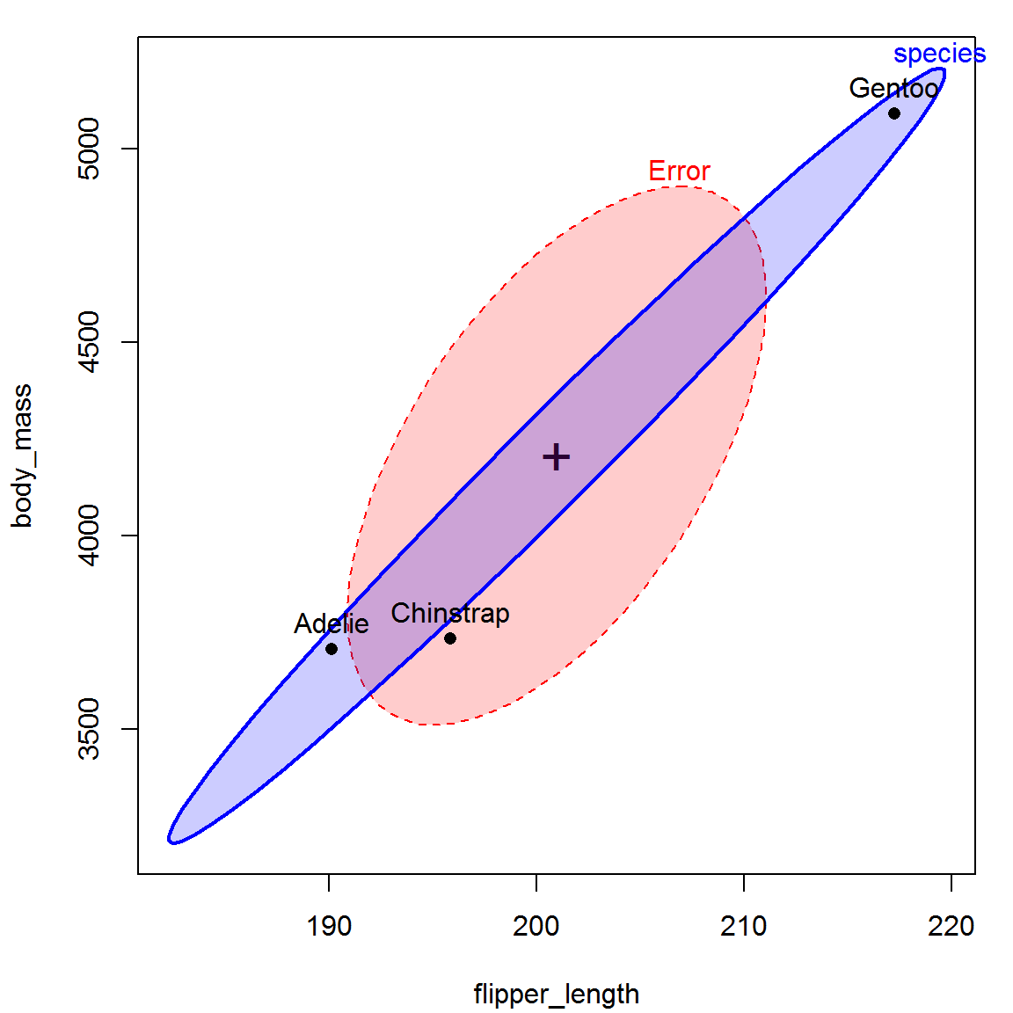
Other HE plots
2D: can plot any pair of responses in data space
pairs.mlm(): all pairwise 2D views
heplot3d(): plots in 3D, can rotate, spin, zoom, …
heplot(peng.mod0, variables=3:4,
fill=TRUE, fill.alpha=0.2, size="effect")
Interpretation:
major axis of the H ellipse measures “penguin size”
Gentoo are the Big Birds in this story!

Slide 55
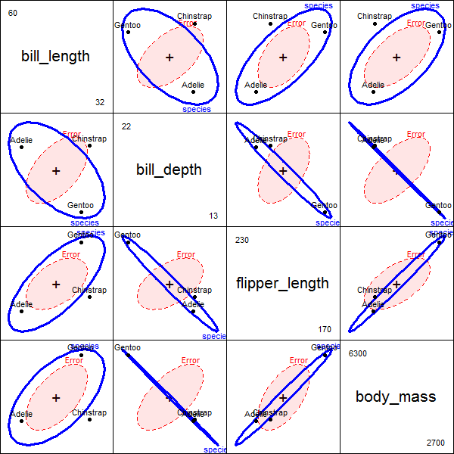
HE Pairs plots
The pairs() method for mlm objects gives all pairwise HE plots in a scatterplot matrix format.
pairs(peng.mod0, size="effect",
fill=c(TRUE, FALSE))
Something new here:
avg. bill depth is negatively correlated with “size” variables – larger penguin species have smaller bill depths (curvature?)
correlation of avg. bill depth with body mass nearly -1

Slide 56
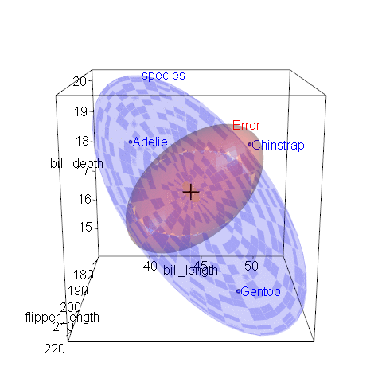
heplot3d()
3D HE plots can show other features
heplot3d(peng.mod0, size="effect")
The H ellipsoid here is flat (2D), because the species effect has 2 df
In this 3D view, the 3 species form a triangle, suggesting some further interpretation, not seen in 2D views

Slide 57
Canonical view
4 response variables, but only s=min(q, dfh)=2 dimensions.
Here, both dimensions are significant
Can1 accounts for 86.5% of between-species variance
Can 2 accounts for the rest: 13.5%
> library(candisc)
> (peng.can <- candisc(peng.mod0))
Canonical Discriminant Analysis for species:
CanRsq Eigenvalue Difference Percent Cumulative
1 0.938 15.03 12.7 86.5 86.5
2 0.700 2.34 12.7 13.5 100.0
Test of H0: The canonical correlations in the
current row and all that follow are zero
LR test stat approx F numDF denDF Pr(> F)
1 0.0187 516 8 654 <2e-16 ***
2 0.2997 255 3 328 <2e-16 ***
---
Signif. codes: 0 ‘***’ 0.001 ‘**’ 0.01 ‘*’ 0.05 ‘.’ 0.1 ‘ ’ 1
✓
✓

Slide 58
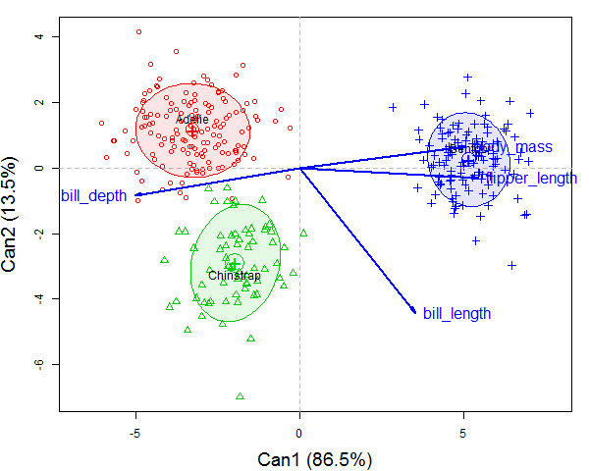
Canonical view
The plot() method for candisc objects shows points for observations and vector for variables
plot(peng.can, ellipse = TRUE … ) #plot CAN scores with ellipses
Can1: largely body mass & flipper length, that separate Gentoo from (Adelie, Chinstrap)
Can2: bill length distinguishes Chinstrap from others.

Slide 59
Canonical HE plot
heplot(peng.can, size="effect", fill=c(TRUE, FALSE))
Here is the entire effect of species shown in one HE plot
In CAN space, residuals are uncorrelated: E = circle
Size of H shows the total effect of species
Variable vectors show how the groups are discriminated.

Slide 60
Checking assumptions
Assumptions in the MLM extend those in univariate models
Linearity: Each y_{i} is linearly related to all xs
Constant variance matrices of residuals
Residuals are multivariate normal
In addition, need to check
No multivariate outliers
No multicollinearity among predictors

Slide 61
Checking assumptions
Linearity: plot each y_{i} against each x_{j}
quantitative x_{j} : plot(y_{i} ~ x_{j}) + loess smooth
factor: boxplots
Constant variance
visual: plot data ellipses for each group
heplots:: covEllipses(data, group=, …)
univariate-- levene test: heplots::leveneTests()
multivariate– Box M test: H₀ : Σ₁ = Σ₂ = …= Σ_{g}
res <- heplots::boxM(); plot(res)
Multivariate outliers
Mahalanobis D² (y_{i}) ~ χ²_{p} : outlier if prob (χ²_{p} ) < .01
Chisquare QQ plot : plot D² (y_{i}) vs. χ²_{p} quantiles: cqplot()

Slide 62
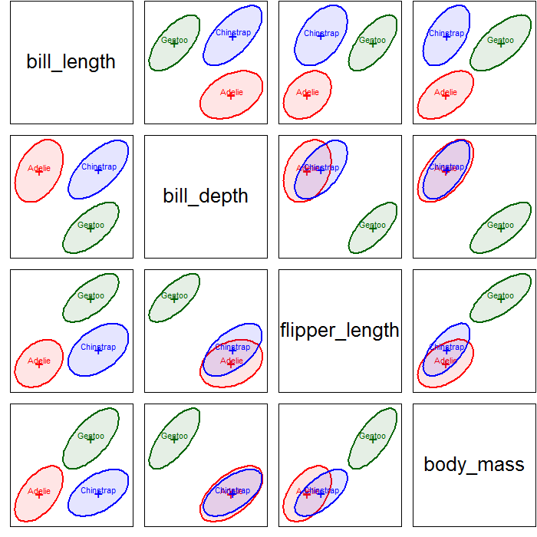
Constant variance: Visual
heplots::covEllipses() plots the data ellipses for each group, for 2+ variables
Are the sizes and shapes & orientations ≅ the same in all panels?
Approximately true, w/ some diff^{ces}
Gentoo looks a bit smaller
Adelie: correlations ~ differ?
This might be good enough
covEllipses(peng[,3:6],
group = peng$species,
variables=1:4, # all pairs
fill=TRUE, fill.alpha=0.1,
pooled=FALSE)

Slide 63

Constant variance: Visual
This is easier to judge if all groups are centered at the grand mean in each panel
covEllipses(peng[,3:6],
group = peng$species,
variables=1:4,
center=TRUE,
fill=TRUE, fill.alpha=0.1,
pooled=FALSE)

Slide 64
Constant variance: statistical tests
Levene tests for each response variable separately:
> heplots::leveneTests(peng[,3:6], group=peng$species)
Levene's Tests for Homogeneity of Variance (center = median)
df1 df2 F value Pr(>F)
bill_length 2 330 2.29 0.1033
bill_depth 2 330 1.91 0.1494
flipper_length 2 330 0.44 0.6426
body_mass 2 330 5.13 0.0064 **
---
Signif. codes: 0 ‘***’ 0.001 ‘**’ 0.01 ‘*’ 0.05 ‘.’ 0.1 ‘ ’ 1
Box’s M test: all responses together – equal variances & correlations !
> heplots::boxM(peng[,3:6], group = peng$species)
Box's M-test for Homogeneity of Covariance Matrices
data: peng[, 3:6]
Chi-Sq (approx.) = 75, df = 20, p-value = 3e-08
NB: Box’s M test is highly sensitive to small diff^{ces}; use  = 0.001

Slide 65


Multivariate normality: z² → D²
For MVN & outliers, Mahalanobis D² generalizes z scores
1 variable: z_{i} = (x_{i} – x̅)/s ~ N(0,1) or, z_{i}² ~ χ²₍₁₎
2 variables, uncorrelated: squared distance from mean is
D_{i}² = z_{i1}² + z_{i2}² ~ χ²₍₂₎
p variables: D_{i}² = Mahalanobis squared distance of x_{i} from centroid

Slide 66

Chi-squared QQ plot
QQ plot of ordered distances, D²_{(i)} vs χ²_{(p)} quantiles should plot as a 45º line through origin if MVN
Multivariate outliers: outside the envelope
Here: both cases check out as OK: no outliers, MVN ✓
heplots::cqplot(df, id.n=3)

Slide 67

Penguins: MVN & outliers
Are penguins normal?
Can you spot the outlier?

Slide 68


Penguins: MVN & outliers
Are penguins normal?
Can you spot the outlier?

Slide 69

Penguins: MVN & outliers
heplots::cqplot(peng.mlm,
id.n = 3, conf=0.999)
Get D² values
with rstatix::mahalanobis_distance
Find z-scores
Select outliers (is.outlier==TRUE)
peng |>
group_by(species) |>
mahalanobis_distance(bill_length:body_mass) |>
tibble::rownames_to_column() |>
mutate(across(bill_length:body_mass,
.fns= scale)) |>
filter(is.outlier == TRUE) |>
as.data.frame()
rowname bill_length bill_depth flipper_length body_mass mahal.dist is.outlier
1 283 2.561 0.3225 -1.425 -0.6297 27.76 TRUE

Slide 70
MVN: Numerical tests
Shapiro-Wilk test
Originally for univariate normality: stats::shapiro.test()
Multivariate version: rstatix::mshapiro_test()
Mardia test: multivariate skewness & kurtosis
But: these are overly-sensitive; MLM is relatively robust
peng |>
select(bill_length : body_mass) |>
rstatix::mshapiro_test()
# A tibble: 1 x 2
statistic p.value
<dbl> <dbl>
1 0.978 0.0000484
res <- MVN::mvn(data = peng[,c(3:6)],
mvnTest="mardia")
res$multivariateNormality
Test Statistic p value Result
1 Mardia Skewness 127.42 < 0.001 NO
2 Mardia Kurtosis -2.51 0.0118 NO
3 MVN <NA> <NA> NO

Slide 71
Summary
MLM just like univariate LM, but for multiple responses
Simultaneous tests – no need for p-value adjustment
Take correlations among responses into account
Indicates # of dimensions of responses
Data ellipses
Summarize bivariate data to show means, variances, correlation
MANOVA: shows how groups differ in these
HE framework
Visualize multivariate tests in the MLM
Canonical displays show these results in the 2D (or 3D) space that accounts for largest between-group variance.
Checking assumptions: visual tests are often sufficient
homogeneity of variances: heplots::covEllipses()
outliers & MVN: heplot::cqplot()

Slide 72
Visualizing MANOVA tests
Data
Data ellipses
SSP_{E} = pooled w/in group
SSP_{H} = var of group means

Slide 73
Within
Total
Between
Within
Total
Between

